Slide 1
ANNUAL MEETING OF SHAREHOLDERS
JULY 14, 2022

Slide 2
Forward-looking Statements
This presentation may contain written and oral statements that constitute forward-looking statements. These forward-looking statements may involve, but are not limited to, comments with respect to our business or financial objectives, our strategies or future actions, our targets, expectations for our financial condition or our outlook for our operations and future earn-out and additional equity interest obligations.
Forward-looking statements are not guarantees of future results, performance, achievements or developments and actual results, performance, achievements or developments may differ materially from those in the forward-looking statements as a result of various factors, including downturns in general economic conditions, consolidation and globalisation of the industry, the highly competitive nature of the quick service restaurant industry, the greater resources available to much larger global players, low entry barriers for new competitors, our ability to successfully integrate our acquired and to-be-acquired businesses and the retention of key management personnel. Assumptions relating to the foregoing involve judgments and risks, all of which are difficult or impossible to predict accurately and many of which are beyond our control.
Although we believe that the expectations reflected in the forward-looking statements are reasonable based on information currently available to us, we cannot assure that the expectations will prove to have been correct. Accordingly you should not place undue reliance on forward-looking statements. In particular, forward-looking statements do not reflect the potential impact of any merger or acquisitions or other business combinations or divestitures that may be announced or completed after such statements are made. Reference should be made to the most recent annual Management’s Discussion and Analysis (“MD&A”) for an in-depth description of major risk factors.

Slide 3
Non-GAAP Measures, Non-GAAP Ratios and Supplementary Financial Measures
Unless otherwise indicated, the financial information presented below, including tabular amounts, is expressed in Canadian dollars and prepared in accordance with International Financial Reporting Standards. MTY uses net income (loss), excluding income tax, all other income (expenses), interest, depreciation and amortization, and net impairment charges (“adjusted EBITDA”), because this measure enables management to assess the Company’s operational performance, and free cash flows (“FCF”), which represents the sum total cash flows from operating activities less capital expenditures net of disposals. These measures are widely accepted financial indicators but are not a measurement determined in accordance with generally accepted accounting principles (“GAAP”) and may not be comparable to those presented by other companies. These non-GAAP measures are intended to provide additional information about the performance of MTY, and should not be considered in isolation or as a substitute for measure of performance prepared in accordance with GAAP.
The Company also discloses supplementary financial measures and non-GAAP ratios as they have been identified as relevant metrics to evaluate the performance of the Company. Supplementary financial measures include system sales, which represents sales of all existing restaurants including those that have closed or have opened during the period, as well as the sales of new concepts acquired from the closing date of the transaction and forward, and digital sales, which represents sales made by customers through online ordering platforms. Non-GAAP ratios include adjusted EBITDA as a % of revenue, which represents adjusted EBITDA divided by revenue, and debt-to-EBITDA, defined as current and long-term debt divided by EBITDA as defined in the credit agreement.
The Company uses these non-GAAP measures, non-GAAP ratios and supplementary financial measures to evaluate the performance of the business as they reflect its ongoing operations. Management believe that certain investors and analysts use adjusted EBITDA to measure a company’s ability to meet payment obligations or as a common measurement to value companies in the industry. Similarly, system sales and digital sales growth provides additional information to investors about the performance of the network that is not available under GAAP. These measures are components in the determination of short-term incentive compensation for some employees.
This presentation should be read in conjunction with the Company’s financial statements and the notes thereto and the MD&A.

Slide 4
Fiscal 2021 in Review

Slide 5
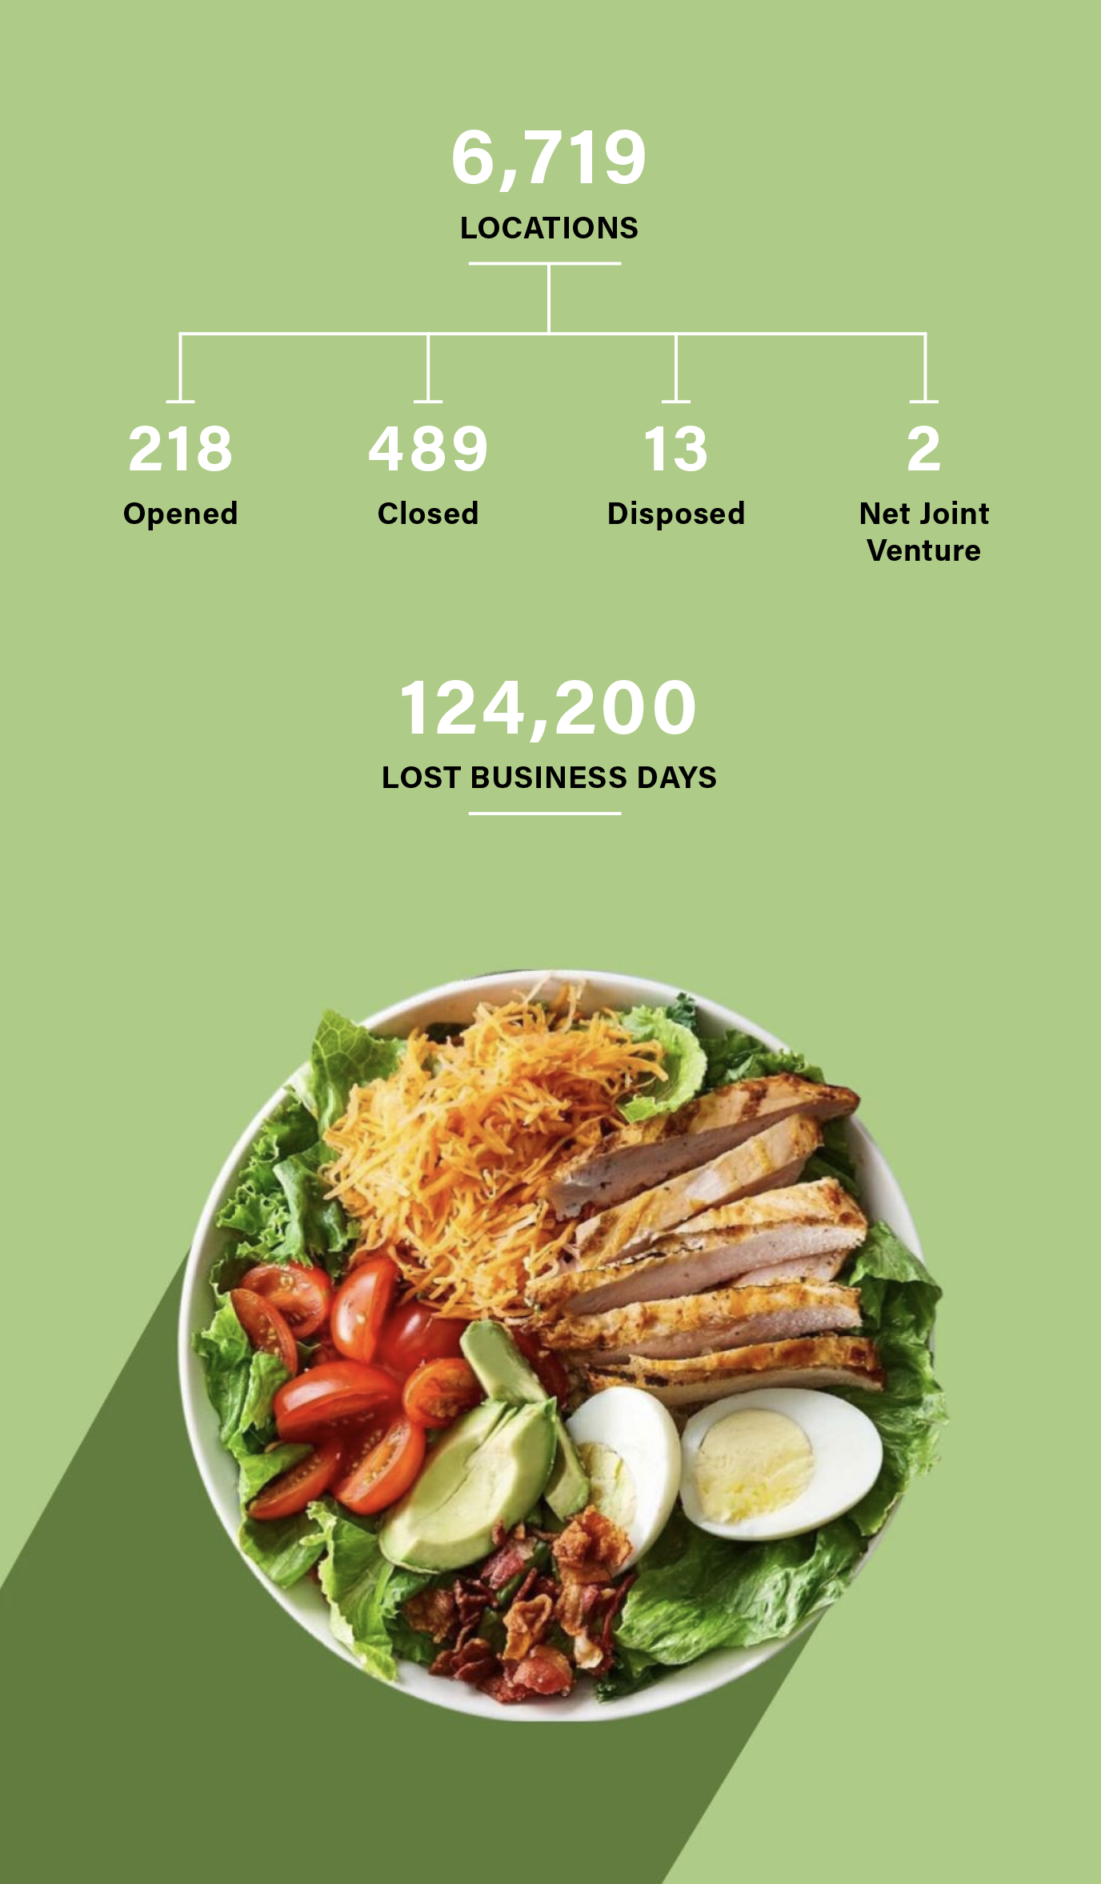
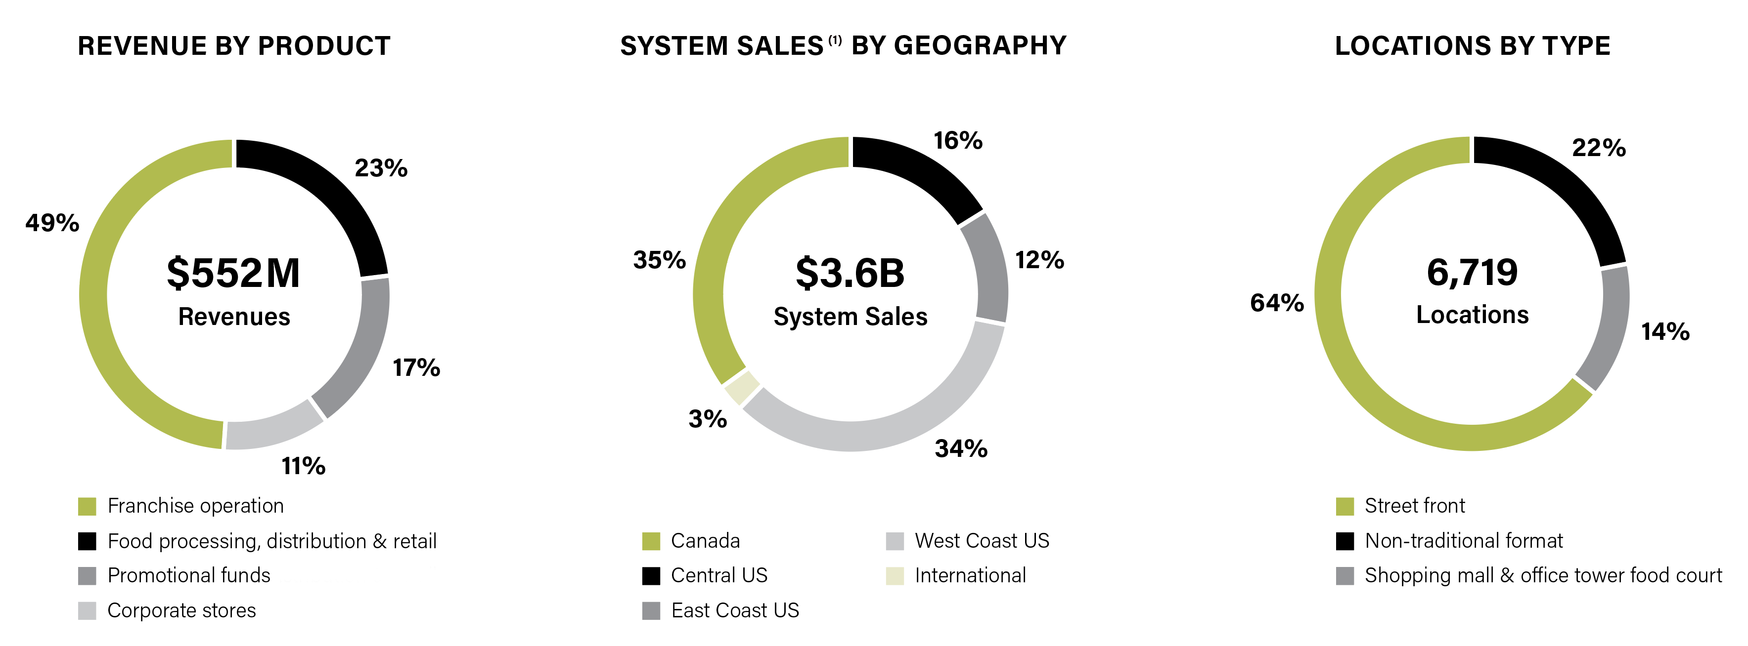
FY 2021 At A Glance
Robust results despite COVID-19 impact
(1) This is a supplementary financial measure. Please refer to page 3 of this presentation.

Slide 6
FY 2021 Highlights
Financial Results
System sales⁽¹⁾ increased 5% to $3.6B
Company revenue improved 8% to $551.9M
Net income attributable to owners totaled $85.6 million
Adjusted EBITDA⁽²⁾ grew 22% to a record-high $168.6M
FCF⁽²⁾ reached $139.0M, $5.62 per diluted share⁽³⁾
Operational Challenges
Locations temporarily closed due to COVID-19
government-imposed restrictions
Supply-chain disruptions
Labour shortages
Food price inflation
This is a Supplemental Financial measure. Please refer to page 3 of this presentation.
This is a non-GAAP measure. Please refer to page 3 of this presentation
This is a non-GAAP ratio. Please refer to page 3 of this presentation

Slide 7
Capital Allocation Strategy
Reinstated quarterly dividend in August 2021 and increased it by 14% to $0.21 per share in January 2022
Sold Houston Industria to original owners in Q3 2021
Closed acquisition of Küto Comptoir à Tartares in December 2021
Renewed Normal Course Issuer Bid in June 2022
With COVID-19 restrictions largely lifted in North America, targeting accretive acquisitions at reasonable valuations

Slide 8
Q2-22 Results

Slide 9
Q2-22 Financial Highlights
This is a non-GAAP measure. Please refer to page 3 of this presentation.
This is a non-GAAP ratio. Please refer to page 3 of this presentation

Slide 10
Q2-22 Network Highlights
Sales:
$0.9B
Sales:
$1.1B
Sales:
$0.9B
Sales:
$1.1B
$1.1B
$0.9B
20.3%
23.6%
(1) This is a Supplementary Financial measure. Please refer to page 3 of this presentation.

Slide 11
Liquidity and Capital Resources—LTM
Prudent Capital Allocation
$80.1M for long-term debt payments
$19.4M for dividend payments
$16.8M for share repurchases
$10.7M for CAPEX and intangibles
Healthy Financial Position
Net debt to adjusted EBITDA ratio⁽¹⁾ of 1.7X
At end of Q2-22, cash on hand of $56.2M and long-term debt of $348.9M
More than $300M in liquidities available, including credit facility and cash on hand
(1) This is a non-GAAP ratio. Please refer to page 3 of this presentation.

Slide 12
Question and Answer Period

